Slide 1

A Guide to Early Years Apprenticeships webinar

Slide 2

Welcome!
This session will cover everything you need to know about Early Years Apprenticeships, from level 2 to 5.

Slide 3


What is an apprenticeship?
An apprenticeship is a learning programme that allows learners to learn while they earn.
Notes:
Apprentices are members of staff
Apprentices must have a contract of employment that covers the duration of their programme
Apprentices cannot contribute to the cost of their training
Apprentices must be allowed time to study
Apprentices must be on programme for a minimum of 12 months
Employers (Mentors) must attend and contribute to the Apprentice Induction and agree the individual learning plan
This is a collaboration whereby BPN supports the Employer and the apprentice

Slide 4
What is an apprenticeship made up of?
Standard (Knowledge, skills and behaviours)
Maths and English functional skills
Off the job training
Gateway
End point assessment
Notes:
Apprenticeship elements:
Standard – knowledge, skills and behaviours to be met
Maths and English FS
Off the job training
Gateway – confirm ready for EPA
EPA

Slide 5

What are the benefits of our Early Years Apprenticeships?
Develop and upskill to excel in your Early Years role
Apprentices put learning into practice straight away, making an immediate impact in their setting
Gain a fully-recognised qualification in line with the EYFS, optimising child:staff ratios for settings
A route into higher education whilst working and gaining practical experience
Develops confidence, communication skills and supports wider learning
Brings new talent into the Early Years sector
Fully funded qualification (95% government funded), always free for the learner

Slide 6
Early years apprenticeships – progression route
Early Years Practitioner level 2 apprenticeship
Early Years Educator level 3 apprenticeship
Early Years Lead Practitioner level 5 apprenticeship
Top up degree in early years
Early Years Initial Teacher Training (EYITT)
Notes:
We are partnered with a university who we can recommend for an online top up degree however we advise enquiring directly with universities on their entry requirements.

Slide 7
Our Delivery Plan
Blended programme of face to face and online study
Specialist 1-2-1 Tutor Support
BPN boost – personal development, career information advice and guidance and welfare programme
Regular reflections on learning and practice
Partnership working between BPN, the apprentice and the employer
Progress reviews every 6 weeks

Slide 8
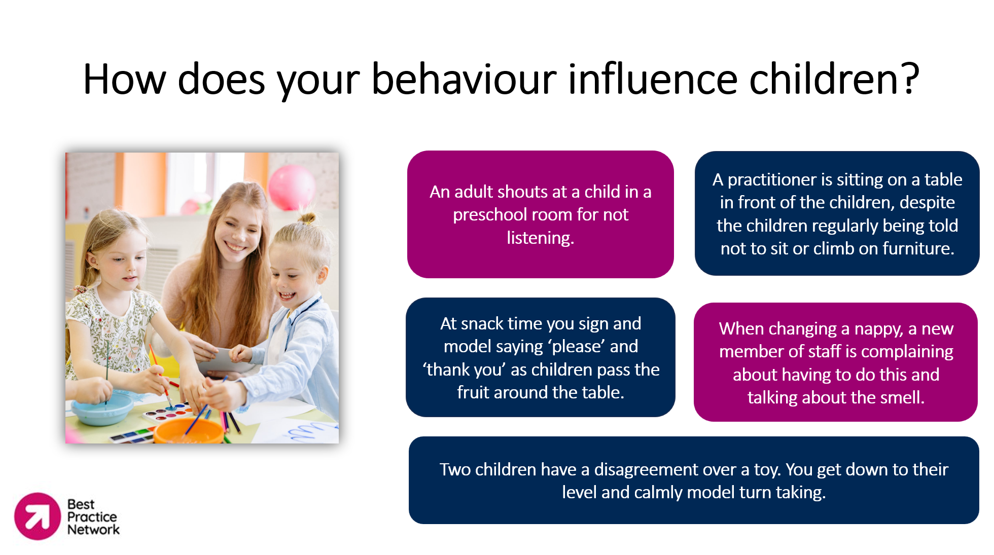

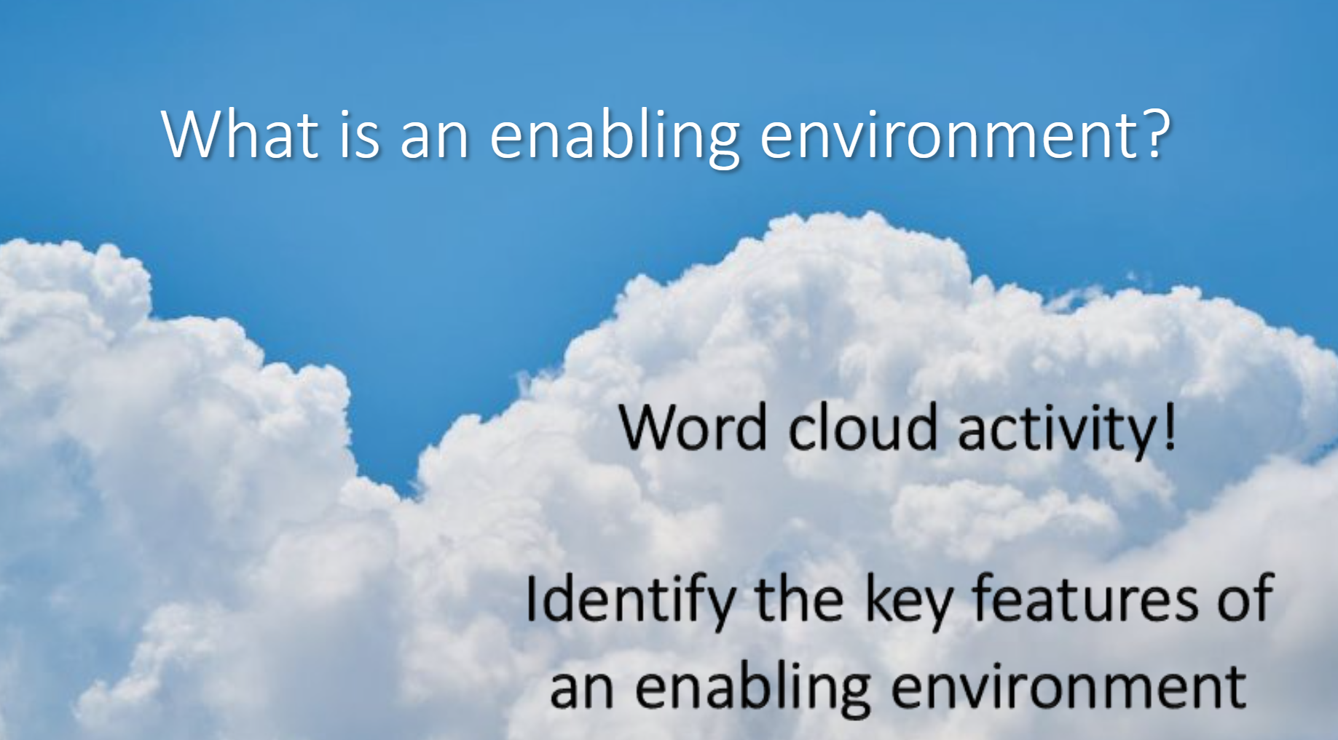
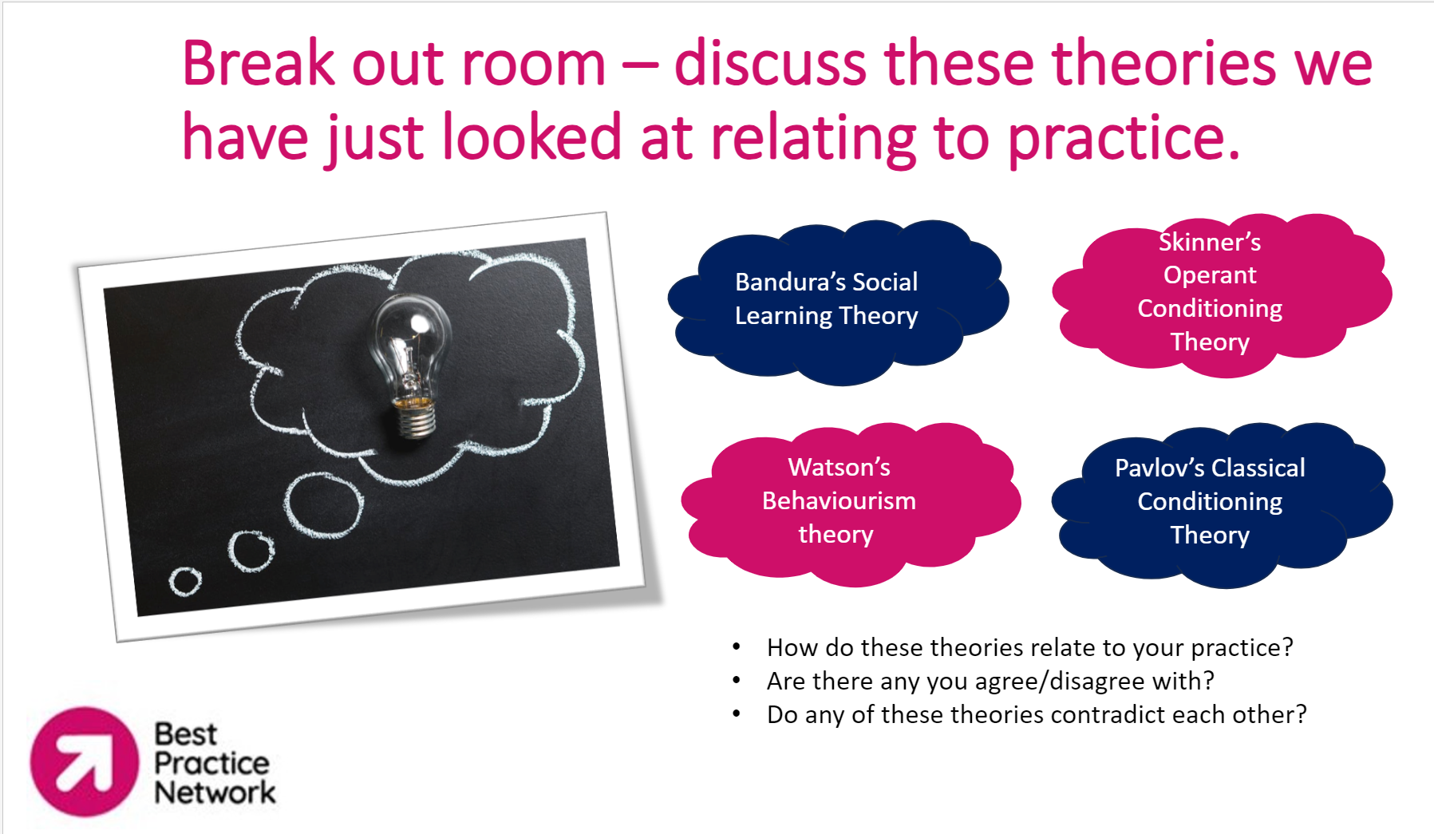
Virtual classrooms
Each month, learners will attend online group virtual classroom sessions.
These are designed to be interactive and engaging sessions.

Slide 9
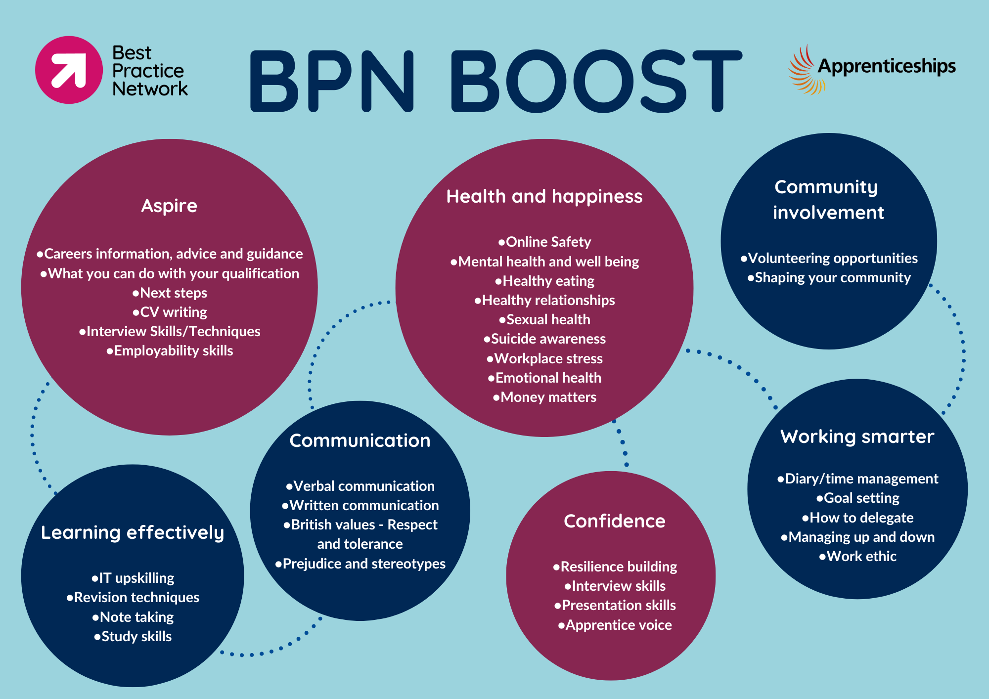
BPN Boost
Online library of resources
Access to Association of Apprentices
Monthly virtual classrooms
Podcasts

Slide 10

Early Years Practitioner Level 2
13 month programme + 3 months EPA (for full time learner)
Functional skills maths and English L1 required if apprentice does not already have equivalent qualifications
L2 NQUAL diploma – Early Years Practitioner
Ideal for learners who are new to an early years setting/the workplace or not quite ready for level 3
Consists of 9 core modules, including child development, health and safety, safeguarding and purposeful play & assessment
EPA methods: multiple choice test and a professional discussion underpinned by a portfolio of evidence
https://www.instituteforapprenticeships.org/apprenticeship-standards/early-years-practitioner-v1-0
Notes:
EYP L2 Apprenticeship
Curriculum plan
Bud build
Webinar booking
Learner journey

Slide 11


Early Years Educator Level 3
15 month programme + 3 months EPA (for full time learner – minimum duration 12 months)
Fully recognised and supports meeting ratio requirements for EYE L3 in an EY setting
Functional skills maths and English L2
Learners will need to complete paediatric first aid and submit their certificate as part of their apprenticeship
Consists of 11 modules + end point assessment preparation – including safeguarding, H&S, child development, a unique child, enabling environments and teaching, learning & assessment
End point assessment methods – observation and questioning, professional discussion and portfolio of evidence
https://www.instituteforapprenticeships.org/apprenticeship-standards/early-years-educator-in-revision
Notes:
EYE L3 Apprenticeship
Curriculum plan
Bud build
Webinar booking
Learner journey

Slide 12

Early Years Lead Practitioner Level 5
18 month programme + 6 months EPA (for full time learner – minimum duration 12 months)
Designed for those in a leadership role in an EY setting
Functional skills maths and English L2
Delivered in cohorts
19 online sessions including leadership practice, the unique child, implementation of legislation and guidance and learning and development
Fully recognised qualification in line with the EYFS
https://www.instituteforapprenticeships.org/apprenticeship-standards/early-years-lead-practitioner-v1-0

Slide 13
Employer requirements
Allow time for apprentices to attend monthly webinars
Provide apprentice with 20% off the job training
Attend learner reviews
Provide your apprentice with a mentor
Provide regular support, feedback and guidance to the apprentice
Provide apprentices with opportunities to develop their knowledge, skills and behaviours
Notes:
All employers will receive an induction as part of the first day of learning. They will also receive physical and electronic copies of the Employer Handbook and Programme Handbook.
Employer Engagement is essential for all Apprenticeships, employers need to be fully aware of their commitment to their apprentice and what they have agreed to, by signing the contracts:
Have a dedicated, allocated mentor for each apprentice who will;
Be actively supportive & involved, for example monitoring the apprentices Bud portfolio
Participate in all face to face and preferably most remote Reviews
Release the Apprentice for observations and reviews
Plan time out of class for attending training events
Provide opportunities for L&D
Understand & support OTJT

Slide 14
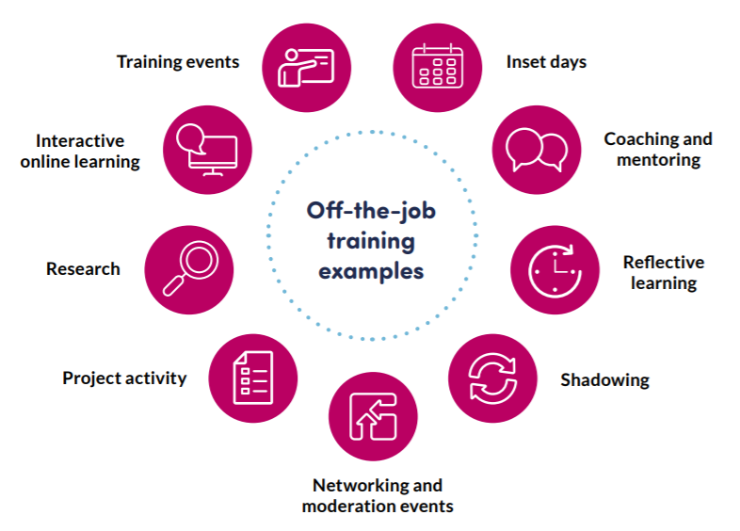
What is Off the Job Training?

Slide 15
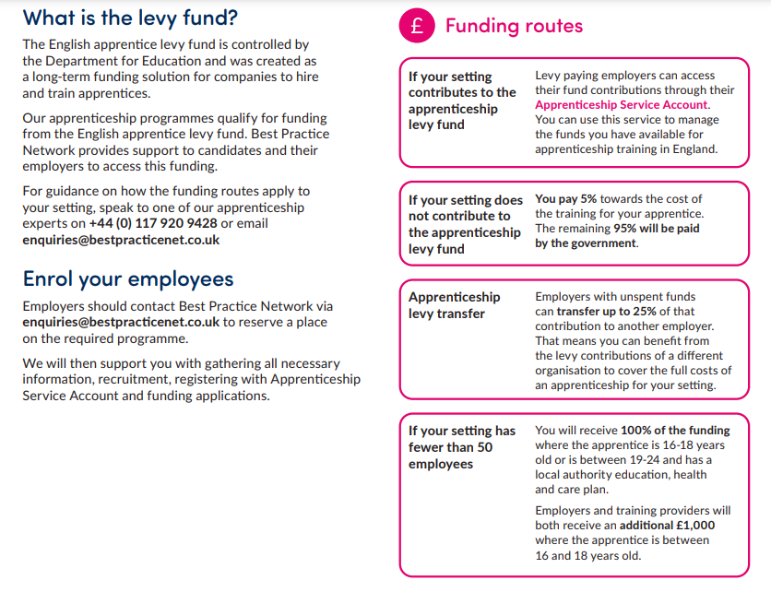
Funding
Early Years Practitioner L2 - £4000
Early Years Educator L3 - £7000
Early Years Lead Practitioner L5 - £8000
Maximum employer contribution: £400
Notes:
Requirements for apprentices:
Must be doing 16 contracted hours per week with employer
Employer must agree to apprenticeship, to support, provide a mentor, give off the job training and to fund the apprenticeship.
Must not be asked to pay for the apprenticeship.

Slide 16


Next steps
Any questions?
Apply by December 22, to start in early 2025!
Apply through our website:
https://www.bestpracticenet.co.uk/early-years

